Slide 1

Open Data Project
Presented by:
Chandni Desai
Deepti Bhatia
Nehaben Kapadiya

Slide 2
Objectives
Provide the city's residents & visitors the most user- friendly & state-of-the-art experience while using open data for their needs.
Data analysis over raw data
Oppurtunity for open data users to access this data in various formats including but not limited to raw data download, charts, APIs for developers

Slide 3
Our Work
Create a User Interface to provide options for data analysis for every open data set
Options include providing answers relating to various specifics of the open data category
Also providing visual representation to data using charts & graphs
APIs for developers

Slide 4
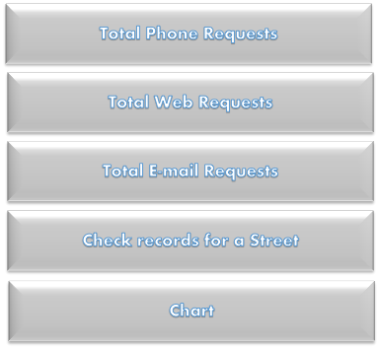
Prototype Design
User Interface:

Slide 5
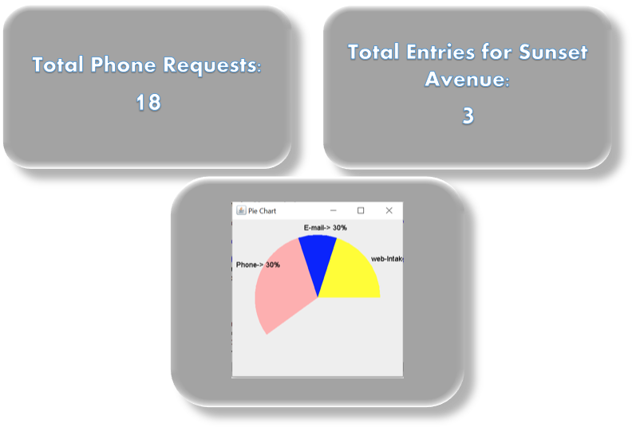
Results:

Slide 6
Overview
Increase in productivity of the end user.
Conversion into Visual format of data for easy analysis.
Quick and accurate decision making.

Slide 7
Plan for Future Iterations
Use of dynamic data fetched from open data portal as a feed for data analysis.
Replace demo data for charts with dynamic data.
Create a User Interface to enable users with options for open data analysis.

